Slide 1

SHA 256 DR.Nadine by hasan A

Slide 2


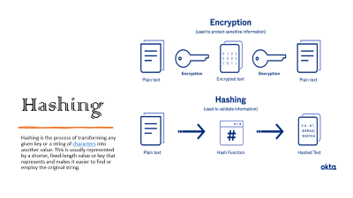

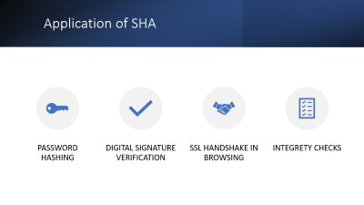

Slide 3
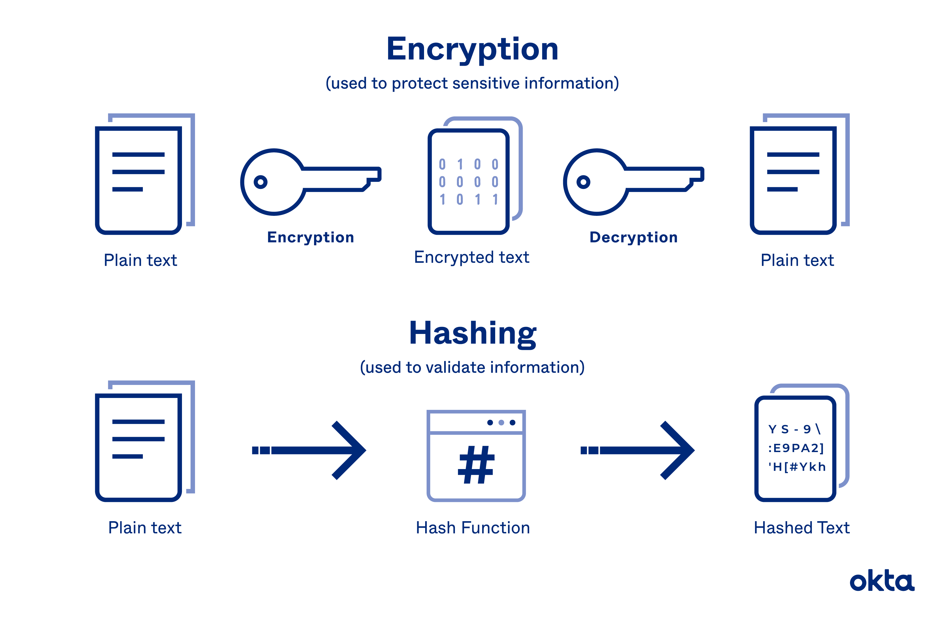
Hashing
Hashing is the process of transforming any given key or a string of characters into another value. This is usually represented by a shorter, fixed-length value or key that represents and makes it easier to find or employ the original string.

Slide 4

SHA256
SHA stands for secure hashing algorithm. SHA is a modified version of MD5 and used for hashing data and certificates. A hashing algorithm shortens the input data into a smaller form that cannot be understood by using bitwise operations, modular additions, and compression functions.

Slide 5

Length of message and key
The SHA-256 can process messages up to 2^64 1 bits in length
SHA-256 doesn’t use a key in the same way as symmetric key cryptography

Slide 6



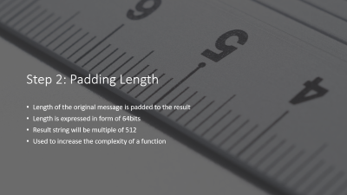
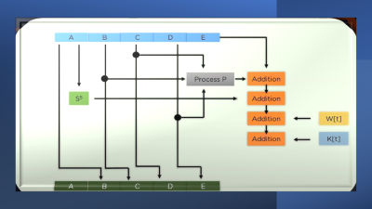
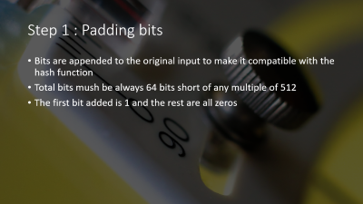
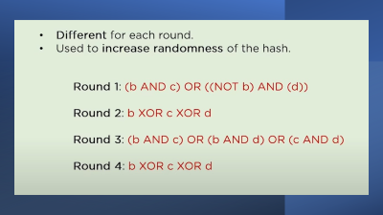
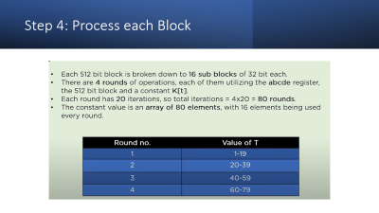
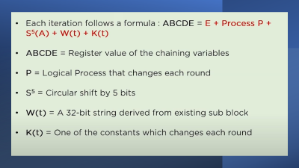
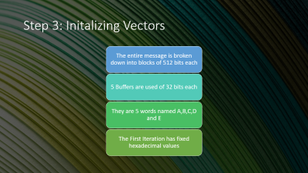
Process Steps
EXIT

Slide 7
Process Steps
EXIT

Slide 8
Process Steps
EXIT

Slide 9
Process Steps
EXIT

Slide 10
Process Steps
EXIT

Slide 11
Process Steps
EXIT

Slide 12
Process Steps
EXIT

Slide 13
Application of SHA
Password Hashing
Digital signature verification
SSL Handshake in browsing
Integrety checks

Slide 14

Case Study
Bitcoin Mining : SHA-256 is employed in the proof of work algorithm Miners compete to find a nonce that when hashed with a blocks data produces a hash that meets certain criteria . The process is computationally intensive and ensures the security and immutablity of the block chain
SHA0256 collision resistance and avalanche effect contribute to its effectiveness in various security applications

Slide 15

DONE BY: Hasan AKIL

Slide 16

THANX FOR WATCHING
Return

Slide 18

Step 1 : Padding bits
Bits are appended to the original input to make it compatible with the hash function
Total bits mush be always 64 bits short of any multiple of 512
The first bit added is 1 and the rest are all zeros

Slide 19

Step 2: Padding Length
Length of the original message is padded to the result
Length is expressed in form of 64bits
Result string will be multiple of 512
Used to increase the complexity of a function

Slide 20

Step 3: Initalizing Vectors
The entire message is broken down into blocks of 512 bits each
5 Buffers are used of 32 bits each
They are 5 words named A,B,C,D and E
The First Iteration has fixed hexadecimal values

Slide 21
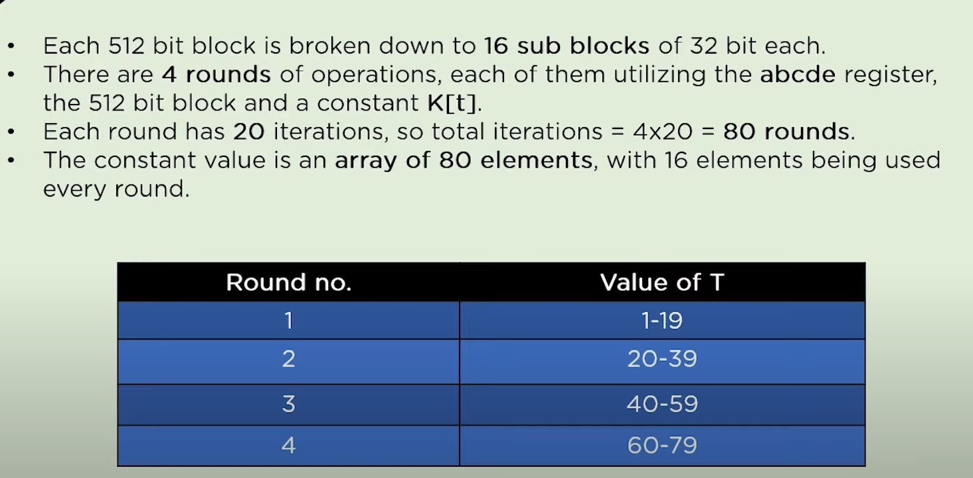
Step 4: Process each Block

Slide 22
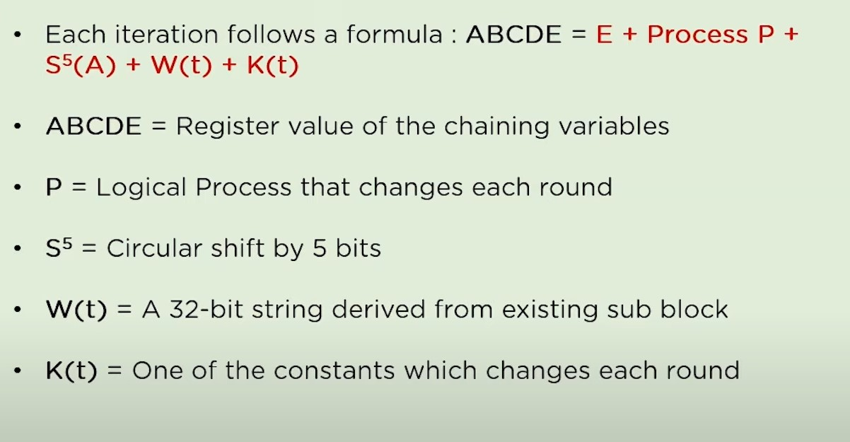

Slide 23
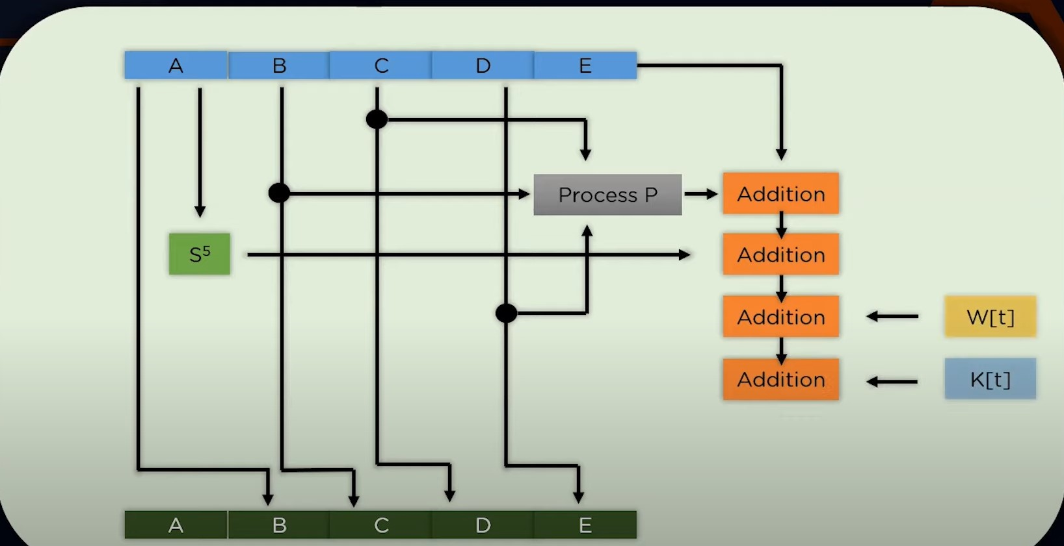

Slide 24
